Slide 1

Maximizing Public Value: Waterfront Public Access and Maritime Capacity
Port of Oakland
June 2, 2022
Danny Wan, Executive Director, Port of Oakland
San Francisco Bay Conservation and Development Commission

Slide 2
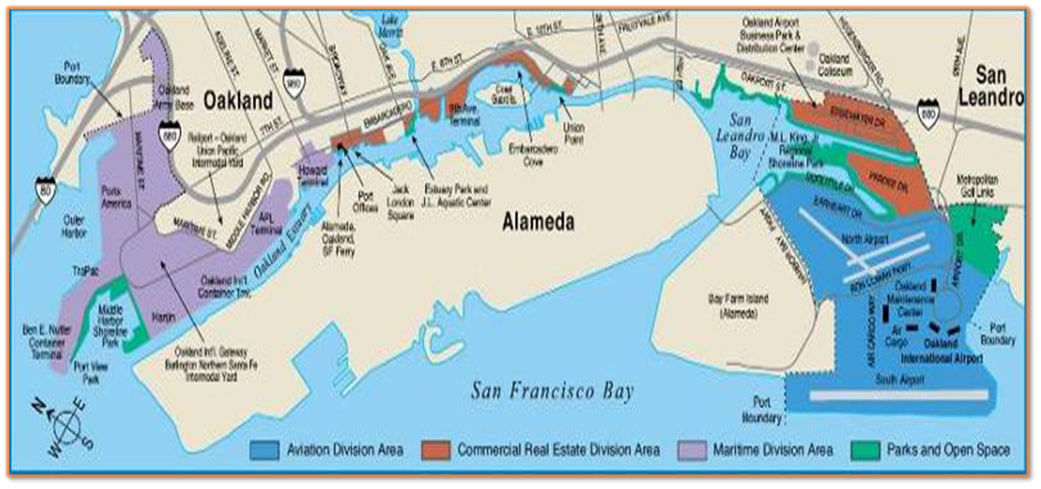
4,000 ACRES FOR REGION’S NEEDS

Slide 3
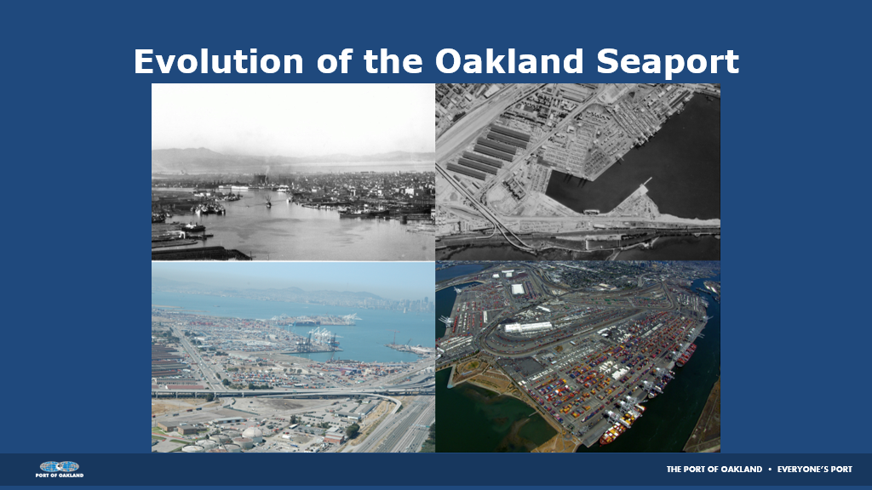
Evolution of Oakland Seaport

Slide 4
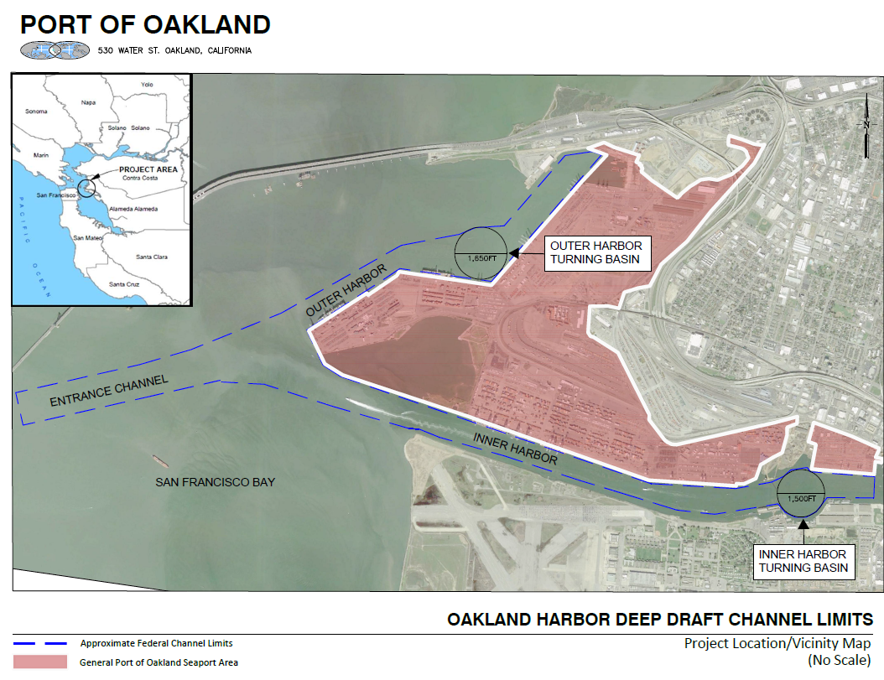
Oakland Harbor Deep Draft Channel Limits

Slide 5
Constraints on Development for Maritime Uses at Howard
Constraints on Development for Maritime Uses at Howard
Small size for modern cargo terminal
Shallow water depth
Non-contiguous/limited expansion
Aging cranes
Sea-level rise flooding
Low financial return

Slide 6
DUE DILIGENCE: HIGHEST AND BEST USE
7/2013: Maritime tenant ends cargo operations
10/2013: Port requests proposals for long-term maritime use
02/2014: Only one conforming proposal. Board rejects coal use
3/2014-4/2018: Discussions yield no long-term tenancy
1/2018: A’s contact Port re: ballpark proposal
5/2019: Exclusive Negotiation Term Sheet with A’s

Slide 7
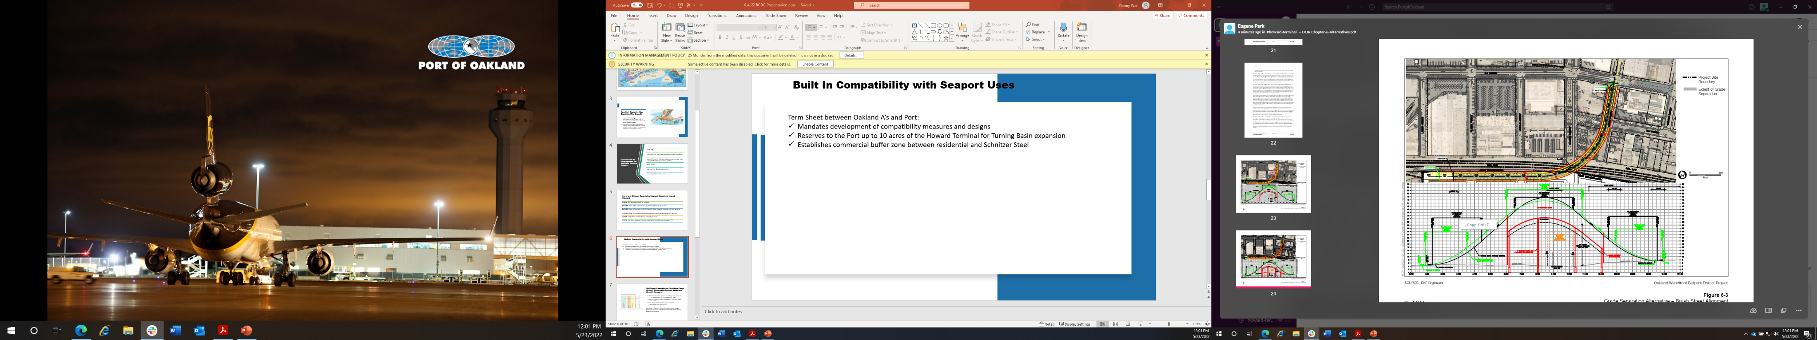
COMPATIBILITY
Term Sheet between Oakland A’s and Port:
Includes development of compatibility measures and designs
Reserves to the Port up to 10 acres of the Howard Terminal for Turning Basin expansion
Establishes commercial buffer zone between residential and Schnitzer Steel
Requires waivers of nuisance claims
City of Oakland EIR:
Maritime and navigation and safety
Seaport access and traffic routes
Safety and avoidance of conflict
Funding for rail safety (e.g., vehicular and pedestrian grade separation
Grade Separation Over Rail Tracks

Slide 8
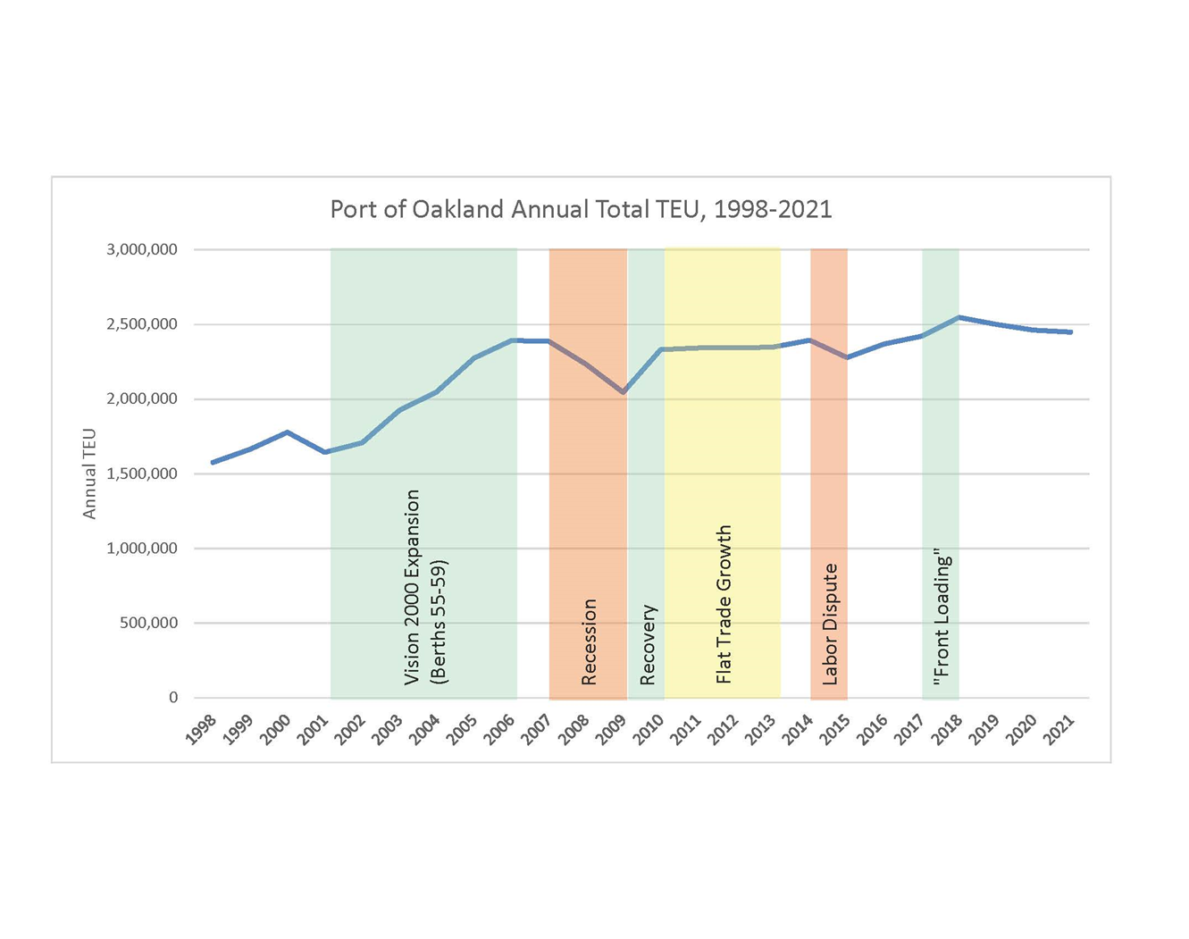
CONTAINER CARGO
2050 Cargo Forecast(Projected): 2.2%
1998-2021(Actual) Cargo Growth: 1.9%
2005-2021(Actual) Cargo Growth: 0.46%
Conclusion: Moderate Growth Needs Met
Forecast is Robust

Slide 9
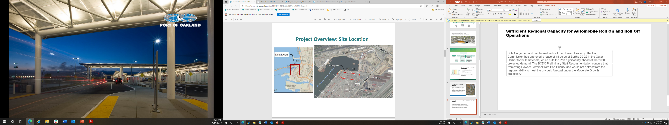
BULK CARGO
18 acres in Oakland Outer Harbor
Sand and aggregates
12-year initial lease
Conclusion: Bulk Cargo Needs Met
Site for sand and aggregate bulk terminal

Slide 10
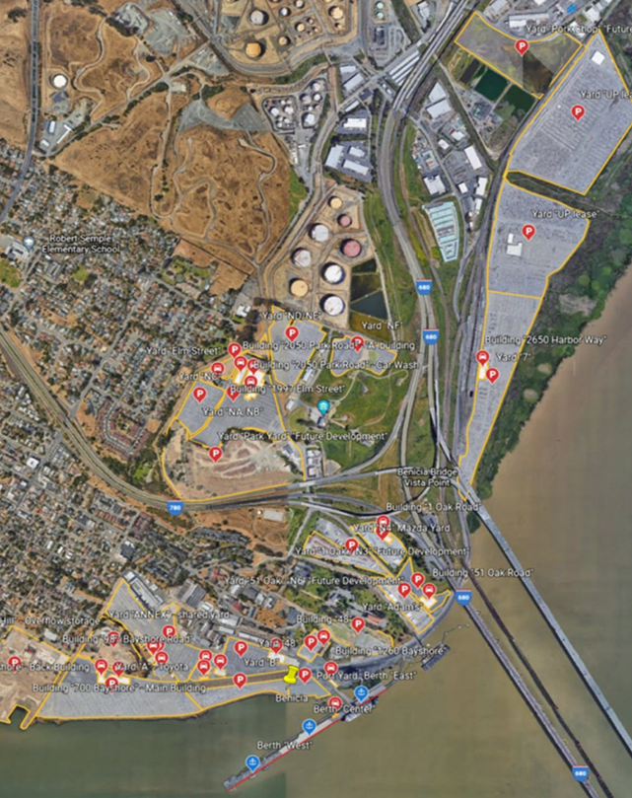
RO-RO CARGO
Benicia, Richmond and San Francisco can expand
Howard not feasible
Exports uncertain
Conclusion: Ro-Ro Cargo Needs Met
Ro-Ro Facilities At Benicia

Slide 11
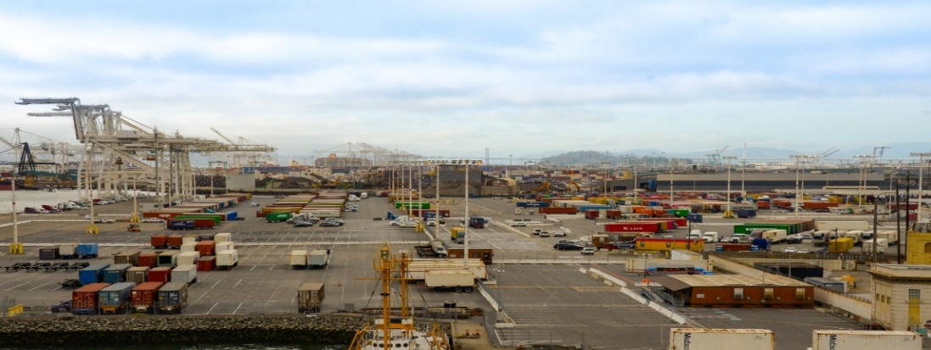
ANCILLARY USES
Sufficient acres at Seaport to meet demand
Truck parking areas already dedicated
Stacking and efficient operations increase capacity and throughput

Slide 12
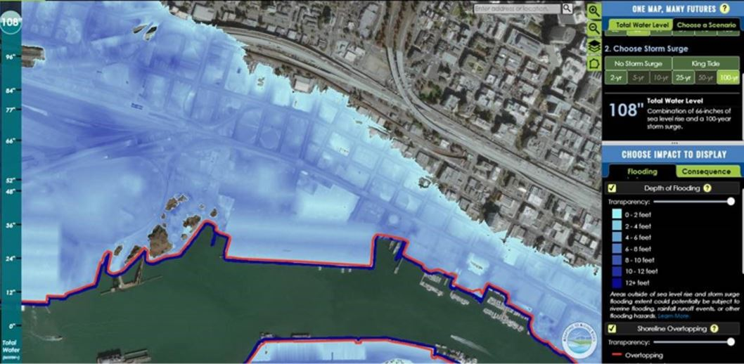
ADAPTING TO RISING TIDES– Sea Level Rise
Notes:
Adapting to Rising Tides scenario that correlates with our 100-year “High” projection of 5.5’ plus 100-year storm surge.

Slide 13
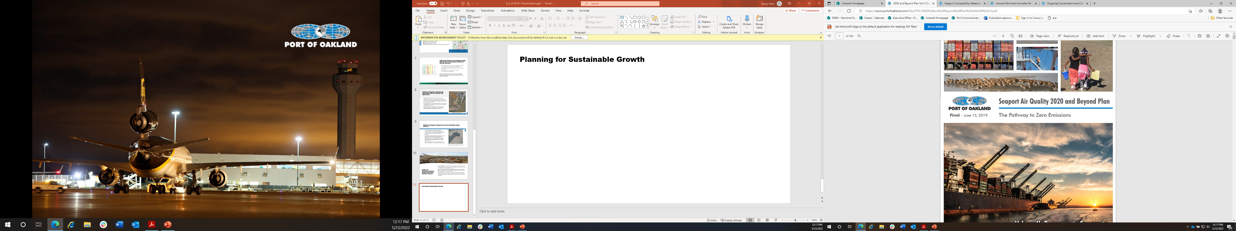
PLANNING FOR SUSTAINABLE GROWTH
Seaport Goals
Incorporates EJ principles
“Pathway to Zero Emissions”
Energy Efficiency
Increased Waterfront Public Access
Notes:
Growing seaport volume sustainably, incorporating principles of environmental justice
Implementing “Pathway to Zero Emissions”
Electrification and energy efficiency must be foundational to new seaport operations development
Public access to waterfront amenities for communities surrounding the Port is important value

