Slide 1

Port of Oakland
This is our time
January 30, 2018

Slide 2
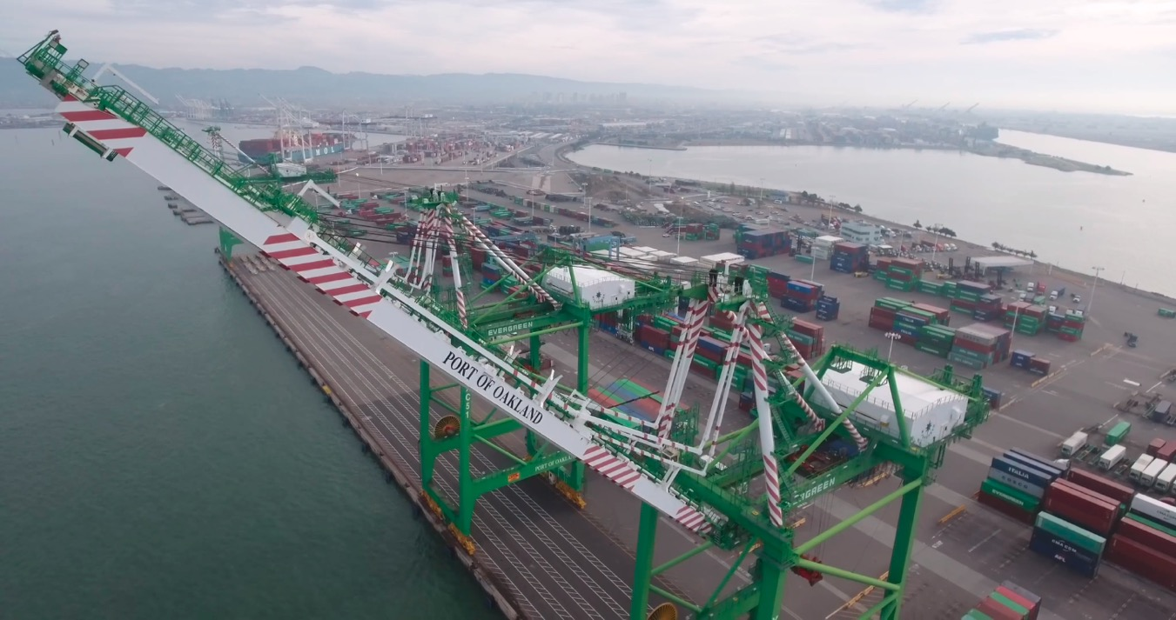
Port of Oakland—a bird's eye view

Slide 3
2017 by the numbers
Operating Revenue, Expenses and Income
($ millions)
Record revenue: $358.7 million
Record volume (imports, loaded, total containers)
Bond refinance saves $43 million
Moody's upgrade

Slide 4

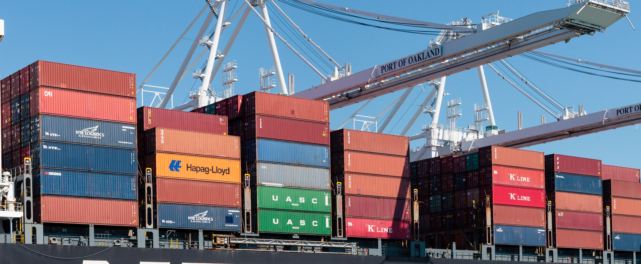

Port of Oakland outlook 2018
“The Port of Oakland serves one of the most vibrant and fast-growing regional economies in the world.”
“Trade via the Port of Oakland influenced by the unique demands of industry and consumers in the Northern California Mega-Region.”
—Jock O’Connell, International Trade Economist
2018 projections for Port of Oakland:
Imports up 2.7 percent from 2017 | Total containers will break 2017 record
Exports up 1-to-2 percent

Slide 5
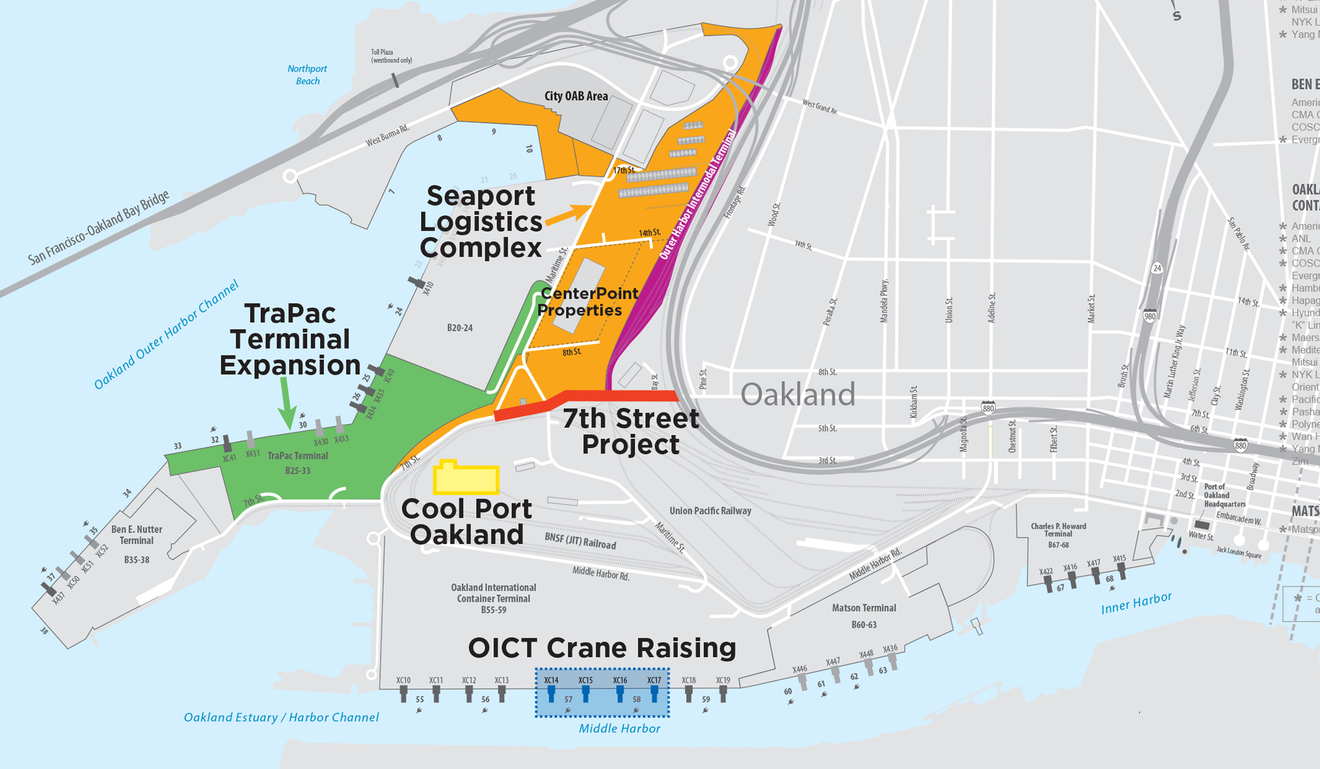
Betting on Oakland
Major investments in 2018
OICT Cranes | $20 million
TraPac expansion | $60 million
Cool Port Oakland | $90 million
Seaport Logistics Complex | $52 million
7th Street Project

Slide 6
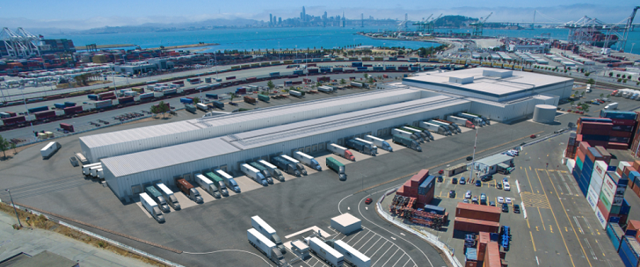
Cool Port Oakland
283,000-square foot refrigerated distribution center
36 rail cars simultaneously
30,000 TEUs annually

Slide 7
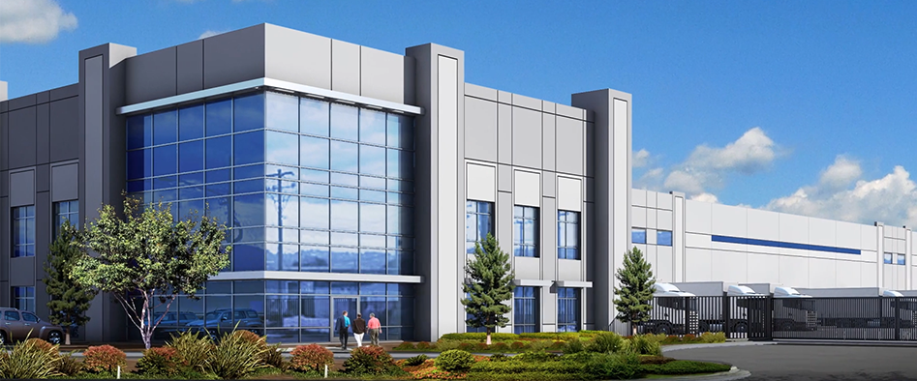
Seaport Logistics Complex
440,000 square feet
Transloading adjacent to rail and ships
Construction begins 2018

Slide 8
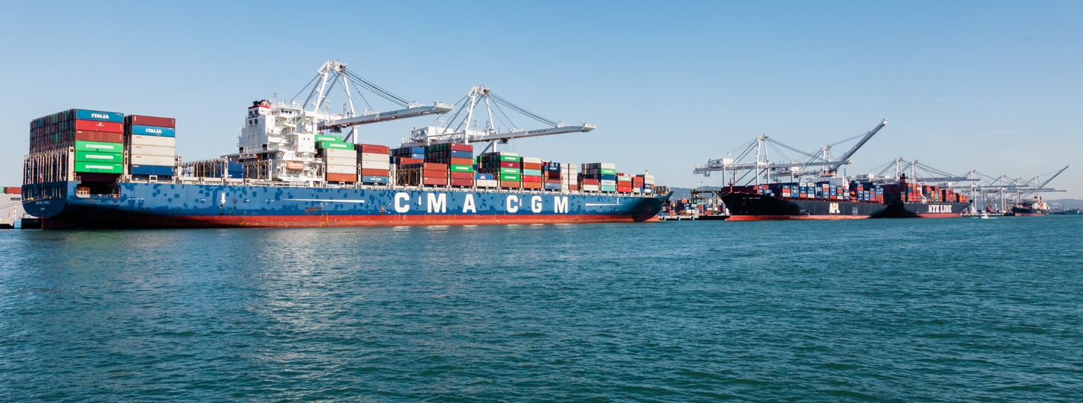
First call in the future
Why Oakland?
Strong Bay Area retail and manufacturing markets
Ample marine terminal capacity
Greater intermodal capability with new railyard
Transload within Port's footprint saves time/cost

Slide 9
Looking ahead
Projecting five more years of record volume

Slide 10
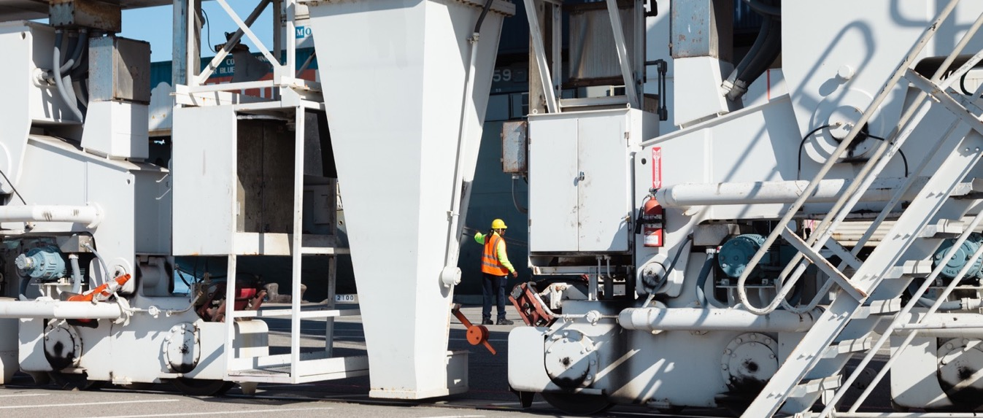
Port of Oakland driving job growth
73,000 depend on the Port of Oakland for jobs
Every additional 1000 containers = eight new jobs
CenterPoint jobs agreement a national model

Slide 11
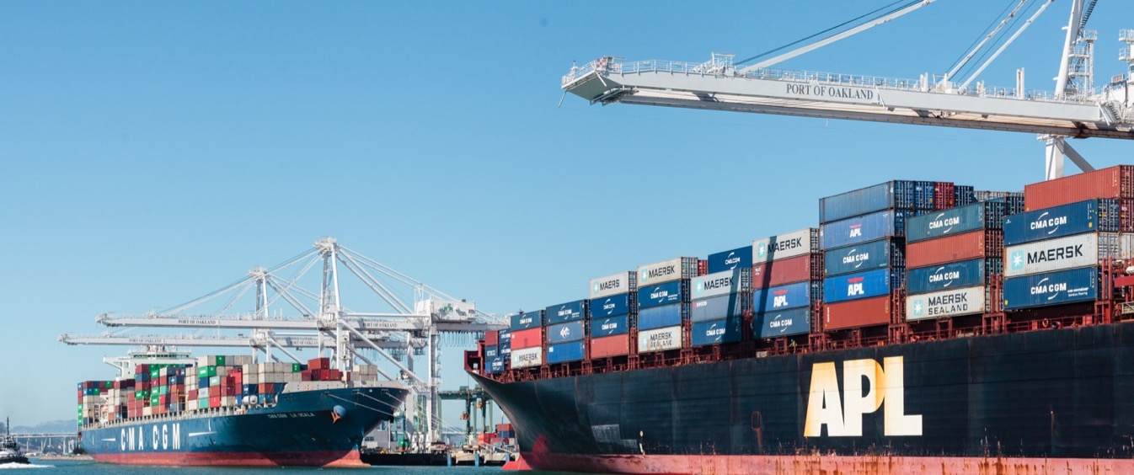
Clean air not pie in the sky
Maritime Air Quality Action plan update
Truck Management Plan update
Shorepower strengthened
Tenants pitching in

Slide 12
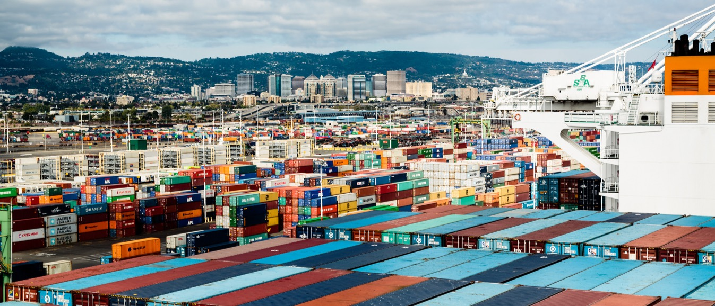
Five-year strategic plan
Published in 2018
Assures that community benefits as Port progresses

